Slide 1
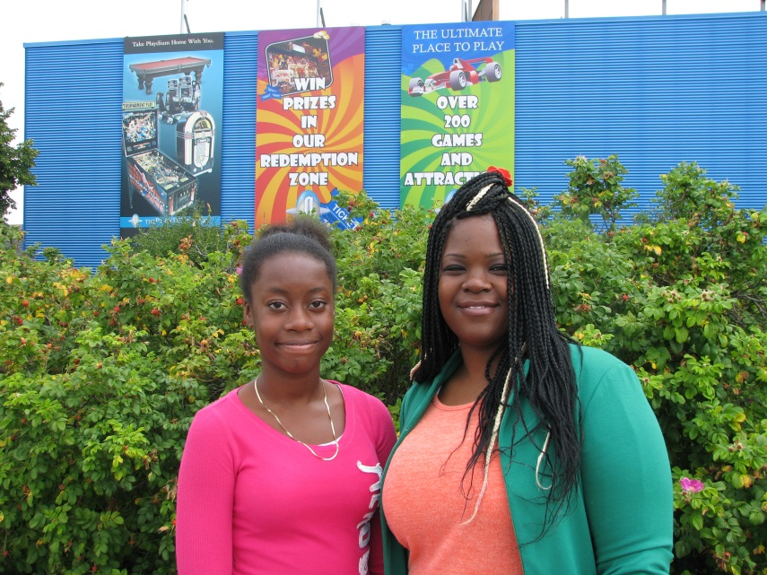
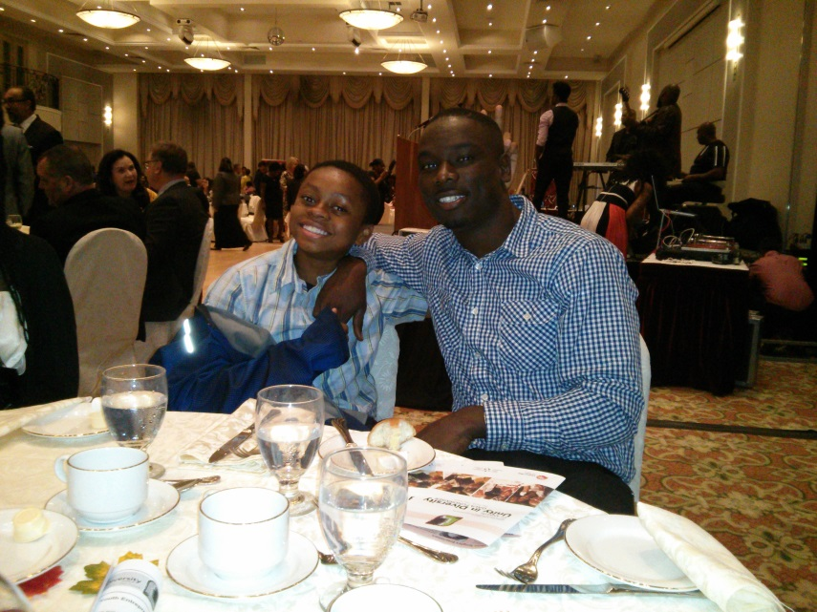
A need… A partnership… Impact in Action
The BCAC Mentoring Program

Slide 2
A Need…
Our community speaks…
Roots of Violence Report
Portraits of Peel 2011 – A Community Left Behind
The Black Community Advisory Council speaks…
Programming needed that was proactive and responsive to the needs and issues of black youth
Big Brothers Big Sisters of Peel speaks…
Snapshot of service base
Our Community Mentoring Programs

Slide 3
A Partnership…
BCAC and Big Brothers Big Sisters of Peel
Steering Committee

Slide 4
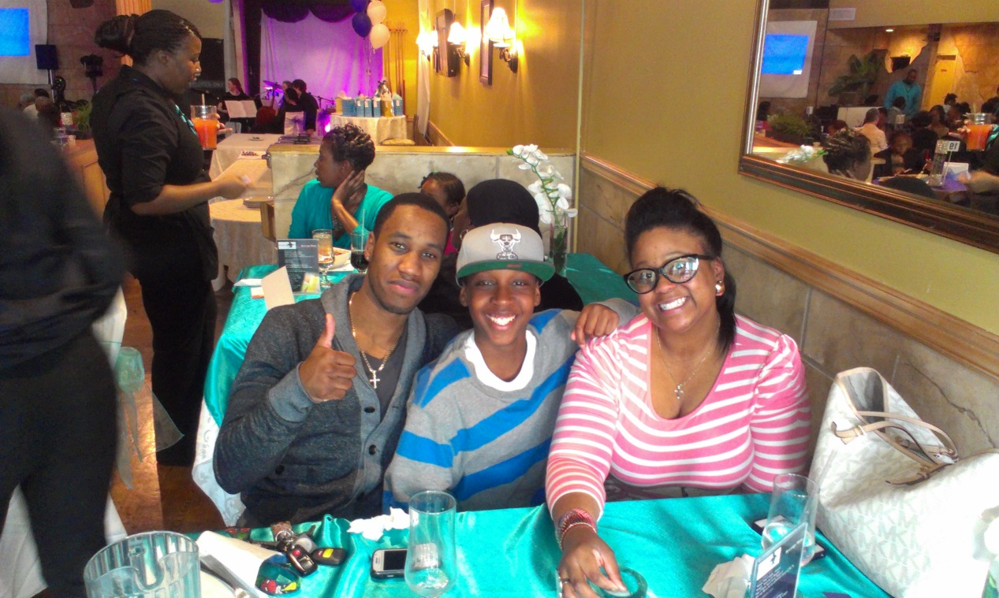
Impact in Action
Program design and implementation
The current landscape
A look ahead

Slide 6
