Slide 1
Punjabi Community Health Services
A New Approach to Addressing Issues of
Marginalized and Racialized Youth
October 2013
Copyright
Baldev Mutta, CEO
Punjabi Community Health Services

Slide 2
Culture – can we afford to ignore its implications
Why is culture important?
Do we need to understand cultural implications in understanding problems?
Can we make a distinction between shyness and depression?
Does body language confuse clinical diagnoses? (Yes means No)
Do we need to understand cultural implications in treatment ?
Does labeling help in treatment of illness?
Learning disability
Autism
Bi-polar

Slide 3
Major Issues of contention
Youth who may have problems associated with:
Mental health
Depression, bi-polar, autism or many other illnesses
Substance abuse
Alcohol and/or drugs
Behavioural problems
Not listening to parents, no motivation, can’t find a goal in life
Cultural issues
An enhanced sense of entitlement in boys in certain cultures
A more preference for boys over girls in certain cultures

Slide 4
Our approach
Only now beginning to recognize mental health issues in youth
Substance abuse + mental health = concurrent disorders
Substance abuse + MH + cultural issues = culcurrent disorders (Baldev Mutta)
Are we even considering this issue?
I don’t think we are considering this at all.

Slide 5
What we should do?
In certain cultures – destinies of youth is “controlled” by parents. Therefore, any work with youth would require to be done in conjunction with parents.
In certain cultures – behavioural problems and mental health problems are “lumped” together. This creates unnecessary suffering for the families.
In certain cultures – mental health is not understood from a “medical point of view”. We as professionals need to put a different twists to developing awareness of the “illness” in the clients.
Clients are not individuals in certain cultures rather they come for help as part of the family – are we prepared to engage the family.

Slide 6
Demographics in Peel
South Asians in Mississauga had the highest unemployment rate (9%) than south Asians in Brampton (8%), Oakville (8%) and Caledon (6%).
In 2005, of the four municipalities, Mississauga had the highest percentage of South Asian families living on low incomes (22.2%), compared to Brampton (18.4%), Oakville (14.5%) and Caledon (6.5%).

Slide 7
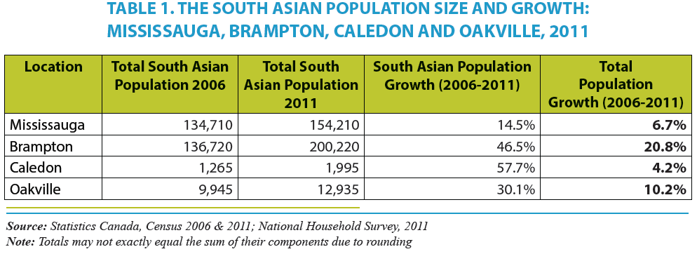
Demographics

Slide 8
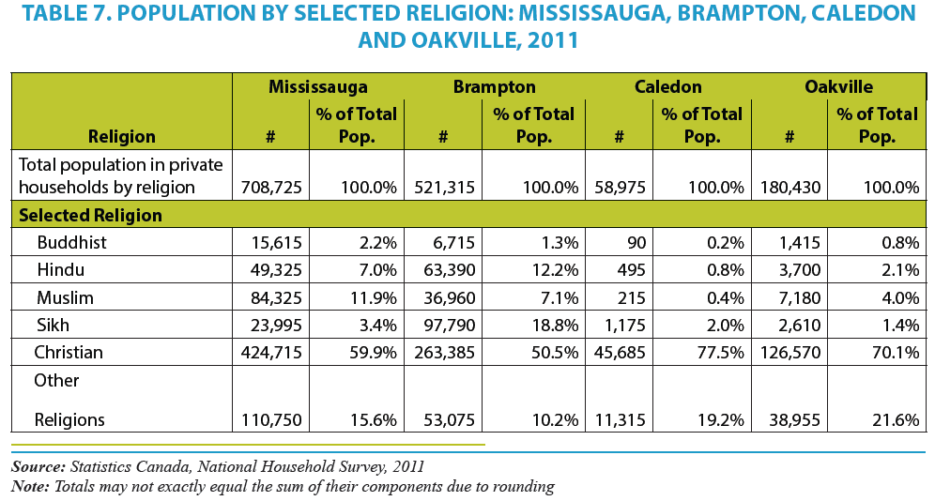

Slide 9
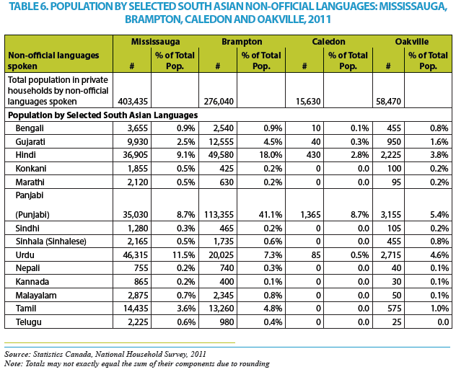

Slide 10
Are we prepared to handle the complexity thrown at us by the diversity?
Understanding culture
Who is our client?
Individual or the family
What does literature say?
Linguistic and cultural barriers must be addressed
Access to services must be addressed
Cross cultural counselling skills forms an important aspect of intervention
Awareness, outreach and support form an important component of intervention
Ethno-specific agencies play a key role in providing culturally appropriate services

Slide 11
Summary
We must discuss multi-dimensional approaches to helping youth with life’s many challenges
We must overcome our ideological differences and work together to help our youth, who are our future
We must walk the talk
Let’s develop a framework of intervention which is based on sound practical principles (not Best Practices or Promising Practices).

Slide 12
THANK YOU

