Slide 1
Making Connections Presentation Deputy Chief Chris McCord Peel Regional Police

Slide 2
The Youth Criminal Justice Act
- In April of 2003, the Youth Criminal Justice Act came into effect as the law governing the youth in Canada.
- The YCJA includes the guiding principles that promote the long-term protection of society
- The YCJA delineates the meaningful consequences for youth that contravene the law, yet focuses on determining underlying causes and rehabilitation

Slide 3
YCJA definition of a “Young Person”
- The YCJA defines a Young Person as someone between the ages of twelve and seventeen

Slide 4
Top Ten Youth Crime Types
1) Assault Level 1
2) Bail Violation – Recognizance/Comply
3) Theft Under – Shoplifting
4) Possession of Cannabis
5) Other – Robberies
6) Assault with Weapon or Causing Bodily Harm
7) Break and Enter – Houses
8) Mischief Over – Property
9) Mischief Under – Property
10) Bail Violation – Fail to Appear

Slide 5
2012 Young Persons Statistics
- In 2012 the Peel Regional Police policing population was 1,264,000
- Young Persons represent 8.3% of the policing population, at 104,634

Slide 6
2012 Young Persons Charge Statistics
- In 2012, 2,541 Young Persons were charged by Peel Regional Police . This is a 9.1% decrease from 2011
- Young Persons represent 13.9% of all persons charged by Peel Regional Police in 2012

Slide 7
2012 Young Persons Charge Statistics
- Crimes Against Persons includes offences such as Assault, Robbery, Sexual offences, Criminal Harassment and Threatening.
- In 2012, 855 Young Persons were charged in relations to one of these offences.
- This represented a decrease of 119, or 12.2% from 2011

Slide 8
2012 Young Persons Charge Statistics
- Crimes Against Property includes offences such as Break and Enter, Thefts, Possession of Property obtained by Crime, Fraud, Mischief and Arson
- In 2012, 801 Young Persons were charged in relations to one of these offences
- This represented a decrease of 167, or 17.3% from 2011

Slide 9
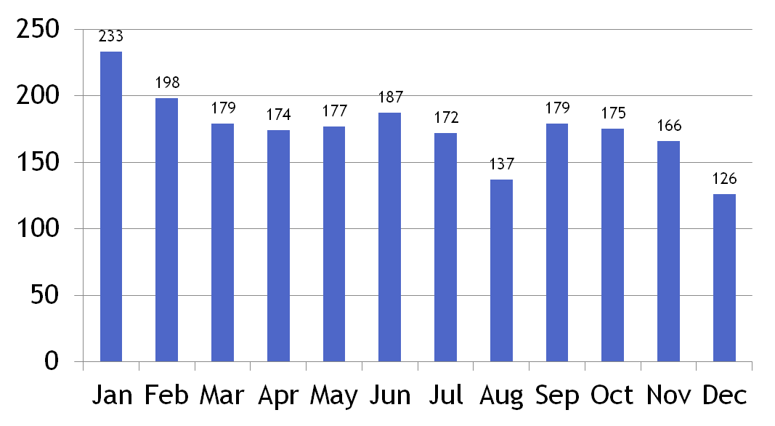
Occurrences with Youth Charged 2012

Slide 10
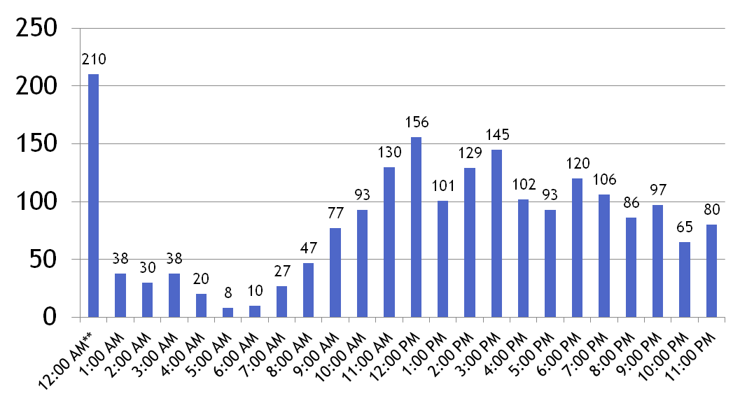
Hour of Occurrences – Youth Charged 2012
** Occurrences with no time indicated default to 12 am

Slide 11
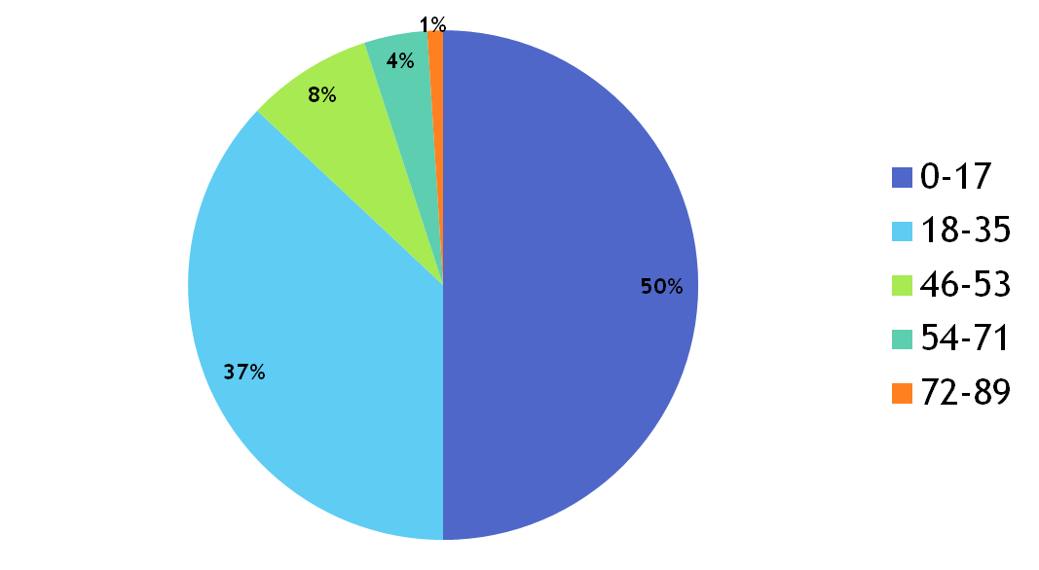
Robbery Victims by Age - 2012

Slide 12
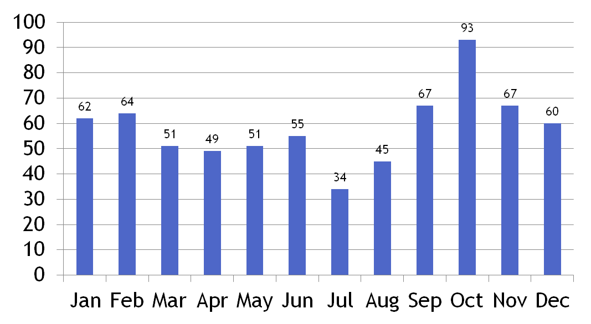
Robbery with Youth Victims 2012

Slide 13
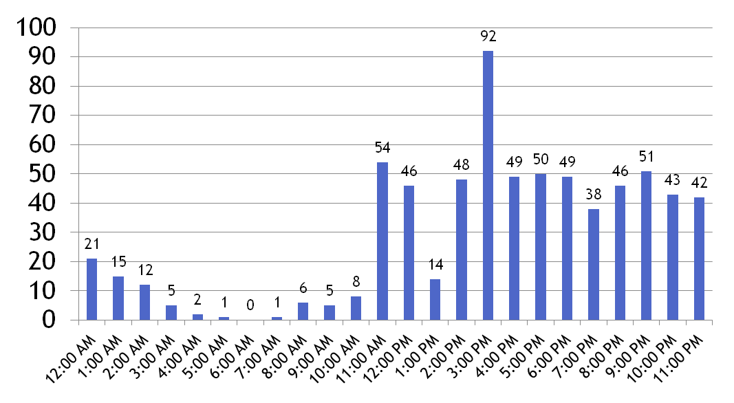
Robbery with Youth Victims - 2012

Slide 14
Youth Diversion Program
12 – 17 years
First time offender
Non Violent crimes
Accept responsibility
Agree to participate
Administered by AYSP

Slide 15
Peel Regional Police Youth Initiatives
- Neighbourhood Policing Units
- Youth Education Bureau
- Youth in Policing Initiative (Y.I.P.I. Program)
- Youth Crime Prevention Academies
- Cyber Academies – including Cyber Bullying
- Youth Investigators

