Slide 1

Protecting Our Water
Environmental Education
Website: peelregion.ca/enviroed

Slide 2
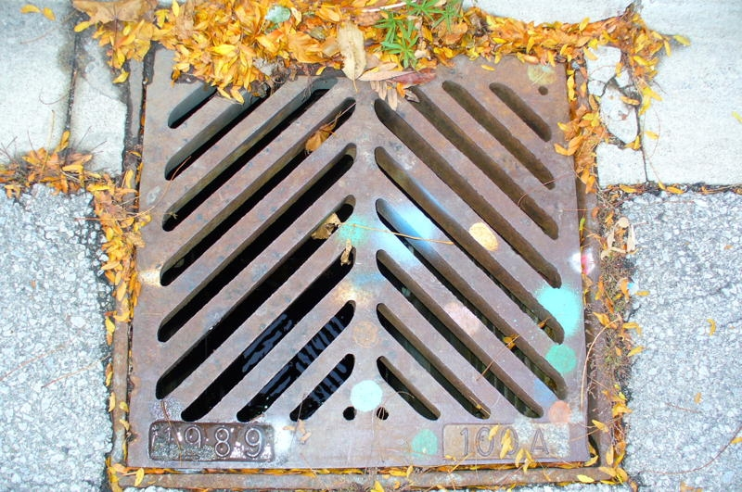
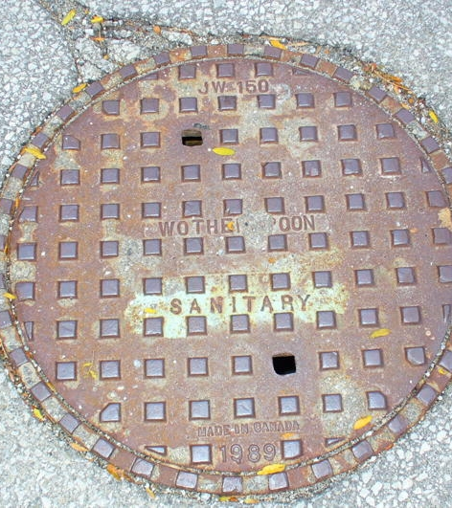
Where does the water go from here?
Storm Sewers
Sanitary Sewers
Notes:
Teacher Note:
Ask: does anyone know what these are? Where can they be found?
Answer: on the streets, school property, parking lot
Ask: what is the difference between these 2 sewers?
Answer: Sanitary Sewers: access point for trained professionals to go down to access the pipes. These trained professionals can open these and if you were there when they opened it, all you would see would be pipes. If there is a blockage or a break in the pipes, they might open this up to fix it
Storm Sewers: used for rain/snow collection so the streets don’t flood. Storm drains transport rainwater and snowmelt to our rivers and creeks, and eventually to Lake Ontario. This water never goes to our wastewater treatment plant, which means that is does not get cleaned before going back to the lake
Ask: where do you think the water goes from the storm sewer? Does the water get treated?
Answer: No, the water goes untreated directly to a stream, creek and eventually to Lake Ontario
Ask: what do you think can be put down the storm sewer?
Discuss the effects of the biodiversity of the Lake. (pollution, garbage, chemicals, soaps all going to the Lake without getting treated), what would the water quality be like?
It is against the law to put anything down a storm sewer other than rainwater or snow, because it can be harmful to the aquatic life in the Lake. Therefore, it is important to not pour any motor oil, paint, or any other fluids that could potentially harm the aquatic life and pollute the water we depend on for so many thing
The next few slides you will guess if these items can go down the storm drain, or if they can’t

Slide 3

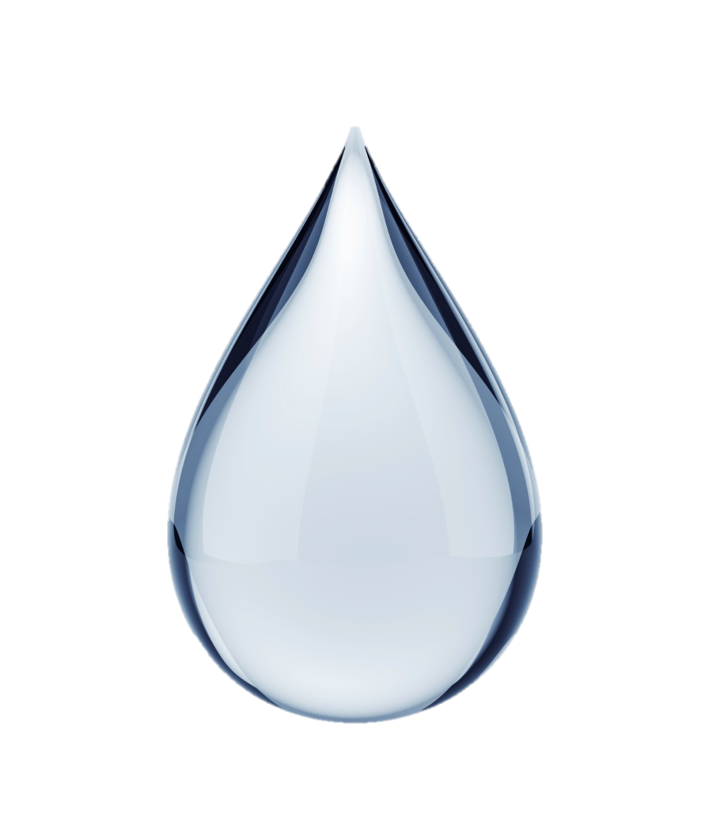
RAINWATER
Notes:
Teacher Note:
Answer: Storm sewers transport rainwater and snowmelt to our rivers and creeks

Slide 4
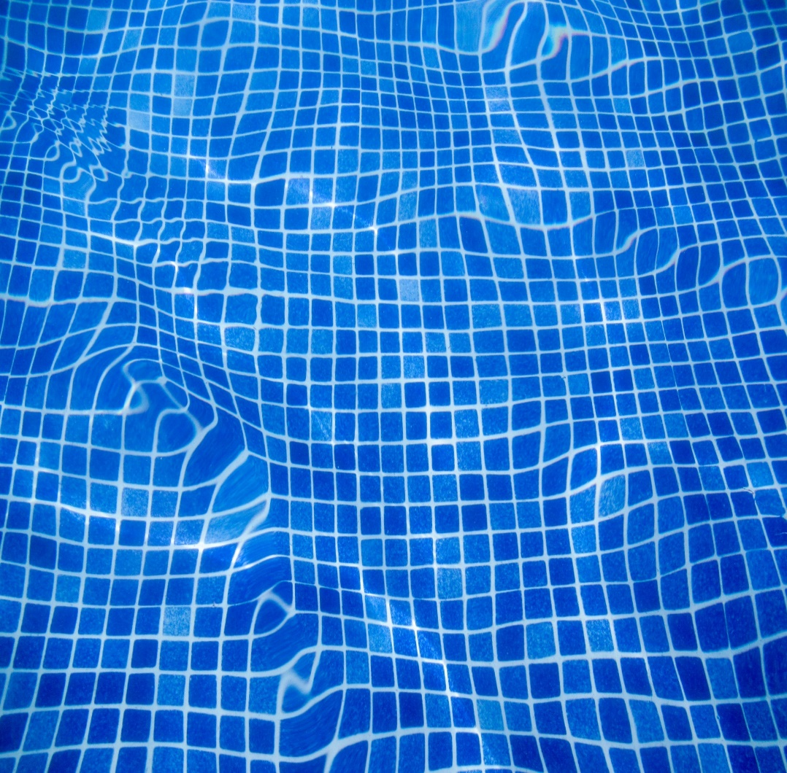
POOL WATER
Notes:
Teacher Note:
Answer: When pool water ends up in the lake, they can harm the aquatic life and lower the quality of the lake water. It is best to let the pool water sit and allow the chemicals, such as the chlorine to dissipate in the air, before dumping the pool water.

Slide 5

MEDICATION
Notes:
Teacher Note:
Answer: When medication ends up in the lake, they can harm the aquatic life and lower the quality of the lake water. It is best to drop off any expired medication to a local Community Recycling Centre for proper disposal

Slide 6
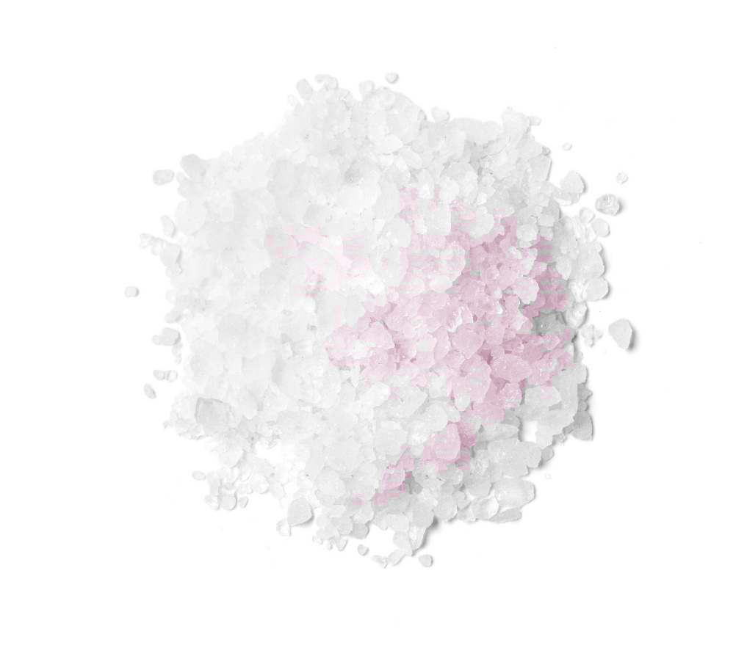
ROADSALT
Notes:
Teacher Note:
When road salt ends up in the lake, they can harm the aquatic life and lower the quality of the lake water. It is best to limit use of road salt during the winter months, or substitute road salt with sand, cat litter

Slide 7
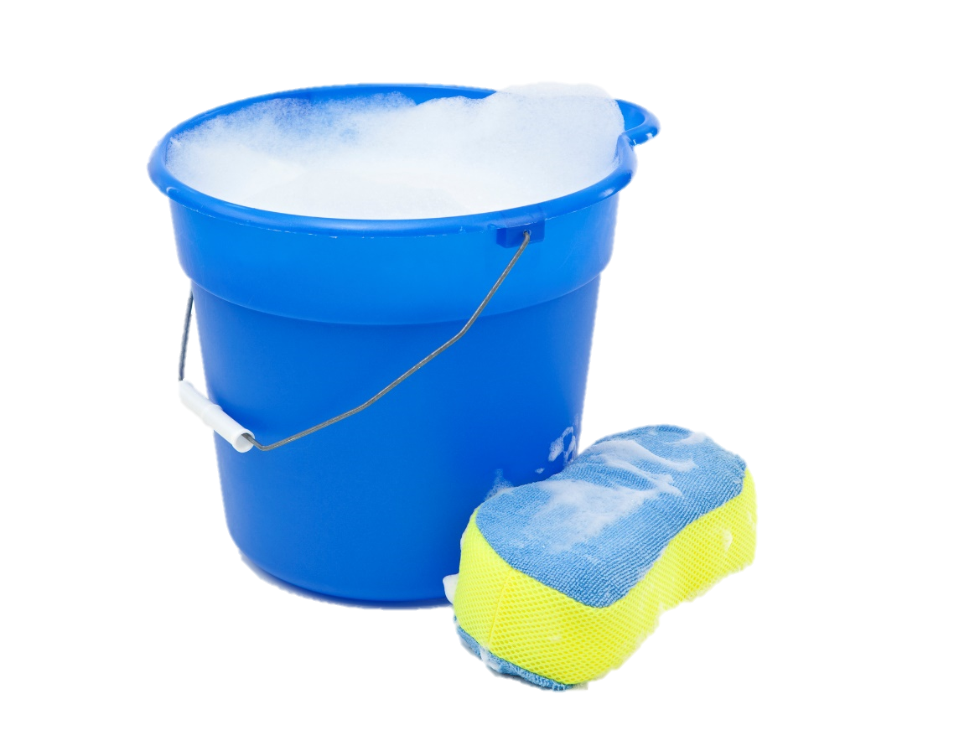
SOAPY WATER
Notes:
Teacher Note:
When all that soapy water ends up in the lake, they can harm the aquatic life and lower the quality of the lake water. It is best to limit car washing on the driveway, or try washing the car on the lawn, use and limit soap that has no phosphates, or harmful chemicals. The best alternative is taking your car to the car-wash

Slide 8

This Photo by Unknown Author is licensed under CC BY-SA
PET WASTE
Notes:
Teacher Note:
When pet waste ends up in the lake, they can harm the aquatic life and lower the quality of the lake water. Always pick up after your pet and properly dispose of pet waste in the garbage

Slide 9

Notes:
Teacher Note:
When oil ends up in the lake, they can harm the aquatic life and lower the quality of the lake water. Always bring your used oil to the Community Recycling Centres for proper disposal

Slide 10
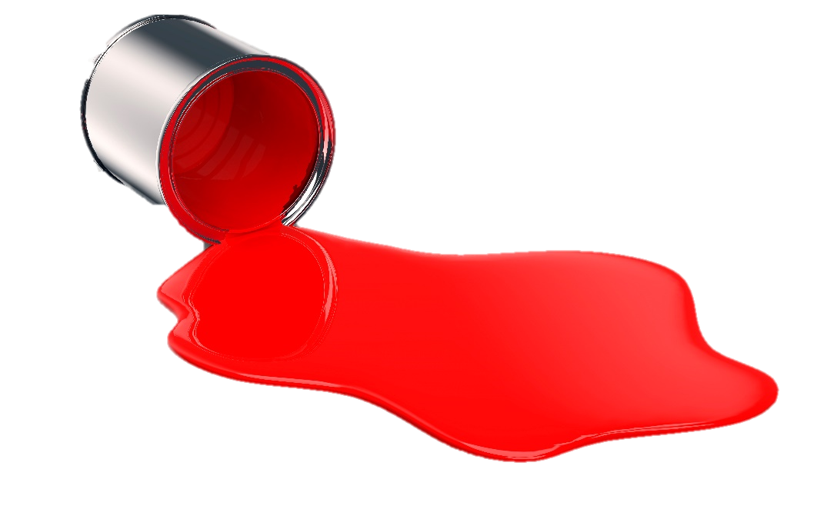
PAINT
Notes:
Teacher Note:
When paint ends up in the lake, they can harm the aquatic life and lower the quality of the lake water. Always bring unused paint to the Community Recycling Centres for proper disposal

Slide 11

PESTICIDES
Notes:
Teacher Note:
When pesticides ends up in the lake, they can harm the aquatic life and lower the quality of the lake water. Try planting native plants that attracts native wildlife

Slide 12
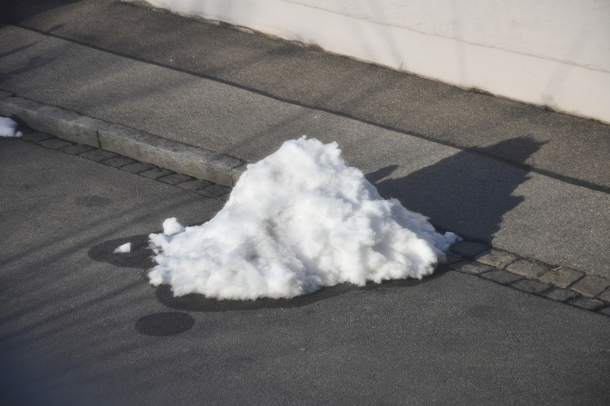
This Photo by Unknown Author is licensed under CC BY-SA-NC
SNOW MELT
Notes:
Teacher Note:
Answer: Storm sewers transport rainwater and snowmelt to our rivers and creeks

Slide 13
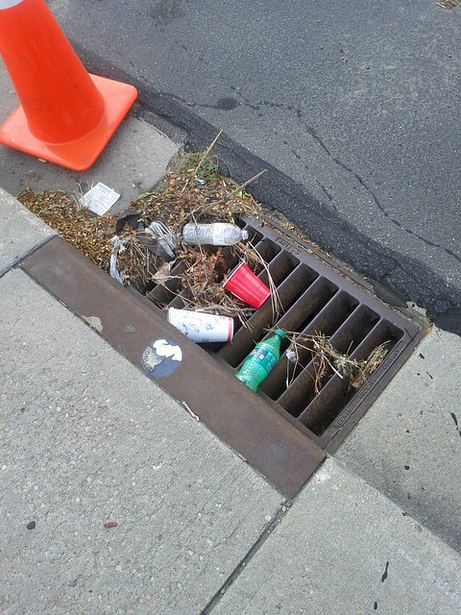
This Photo by Unknown Author is licensed under CC BY-ND
GARBAGE
Notes:
Teacher Note:
When garbage ends up in the lake, they can harm the aquatic life and lower the quality of the lake water. Never litter, properly dispose of your items in their correct bins.

Slide 14

What have you learned today about storm sewers?
Remember:
Everyone plays a part in protecting and conserving our water!
Notes:
Teacher Note:

