Slide 1

Wastewater Treatment
In the Region of Peel
peelregion.ca/water-education

Slide 2

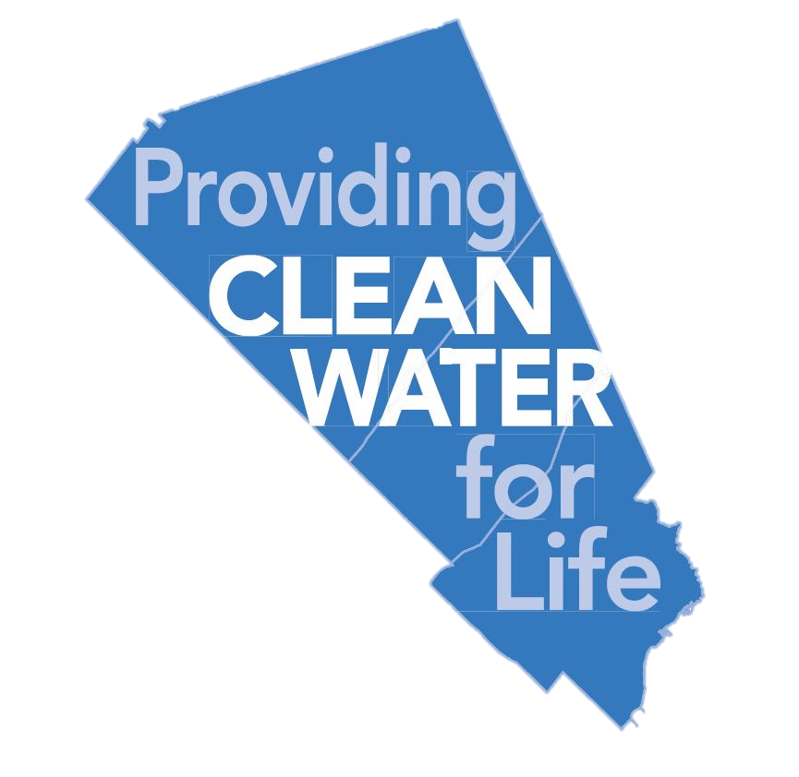


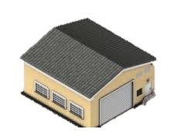
P
E
E
L
Town of Caledon
City of Brampton
City of Mississauga
This Photo by Unknown Author is licensed under CC BY-NC
2 water treatment plants
Arthur P. Kennedy & Lorne Park
1.51 million
residents
3 wastewater
treatment plants (WWTP)
GE Booth, Clarkson & Inglewood
15 wells
(Municipal)
Notes:
Teacher Note:
(Click-2) Region of Peel includes the Town of Caledon and 2 cities – City of Brampton and City of Mississauga
The Region of Peel is a level of municipal government and some of the programs and services that the Region of Peel provides to our communities includes:
Recycling and Waste collections and disposal
Maintenance of regional roads, including snowploughing in the winter and paving in the summer
Health services
Ambulance services
Peel Regional Police and services and
Peel Region also provides you with clean, safe drinking water and wastewater treatment
(Click-3) Peel has a population of 1.51 million people, who make up this vibrant community where people live, work and play
Town of Caledon’s population is 86,000 people
City of Brampton’s population is 676,000 people
City of Mississauga’s population is 748,000 people
(Click-4) Region of Peel has 2 water treatment plants, in Mississauga and (Click-5) 3 wastewater treatment plants, 2 for South Peel and 1 in Inglewood, and (Click-6) 15 municipal wells that treat water that we use daily
Most of these plants are located in Mississauga, close to Lake Ontario as it allows the Region to treat and clean water and wastewater faster and more efficiently
Discussion Questions:
Think about how we use water in our every day lives
Where does our wastewater end up?

Slide 3
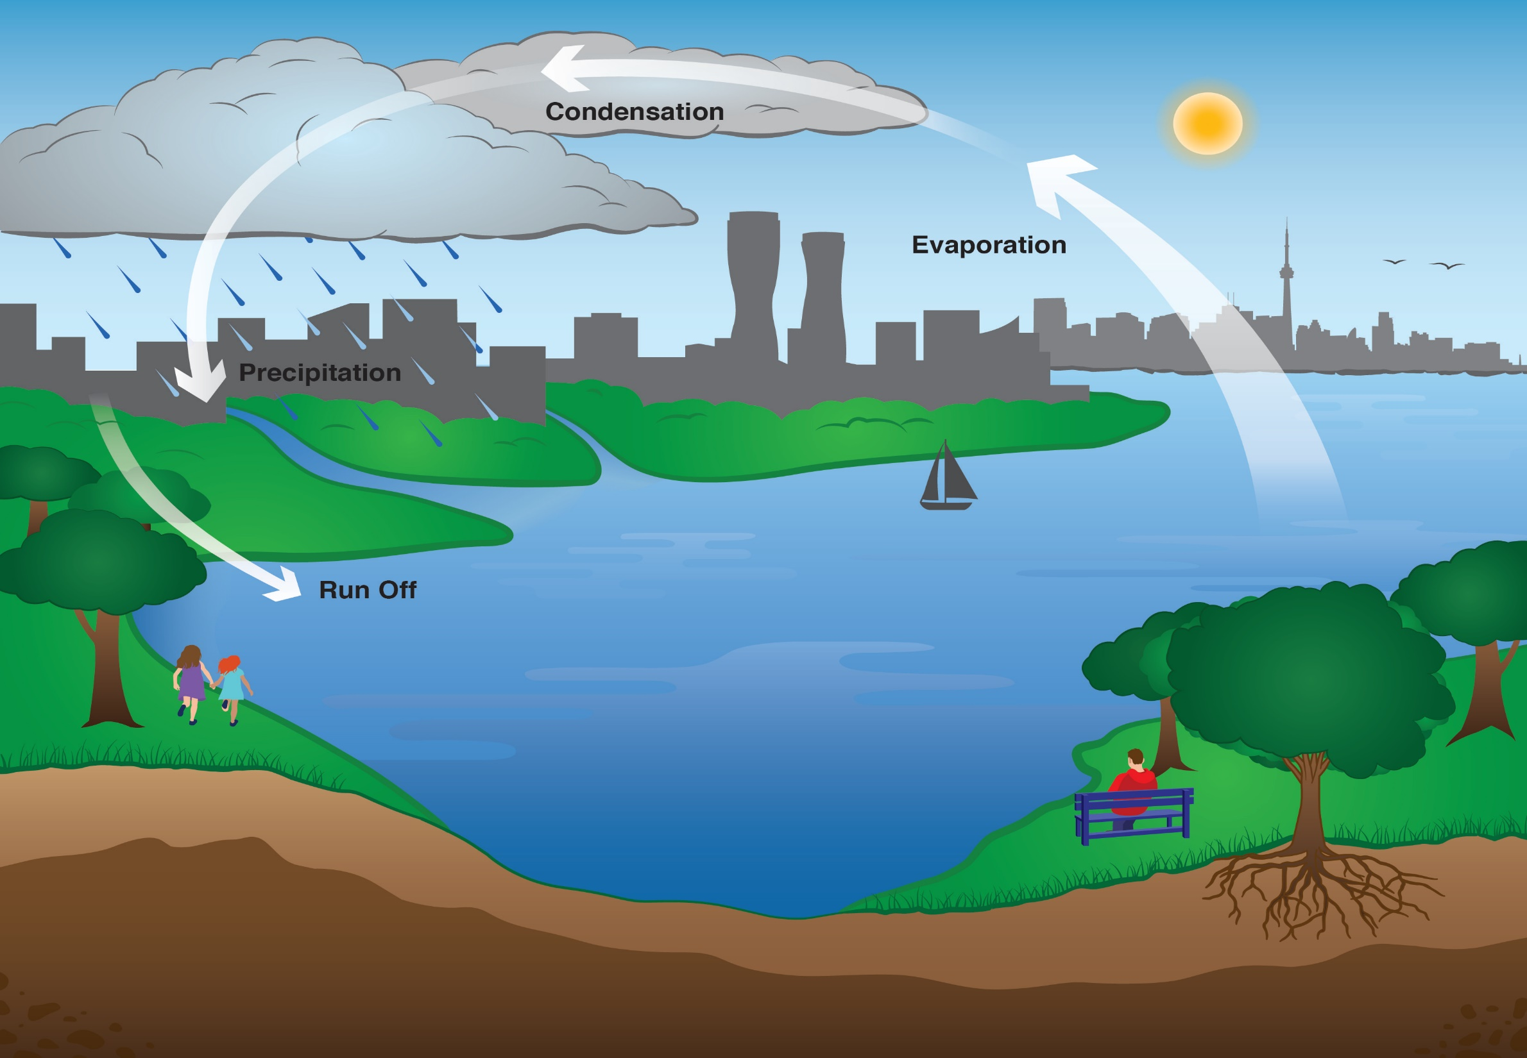
Sun
Condensation
Evaporation
Precipitation
THE WATER CYCLE
Runoff
Lake Ontario
Notes:
Teacher Note:
Review the water cycle with students
Where do we in the Region of Peel get our water from?
Brampton, Mississauga and parts of Caledon get water from the Lake. Other people who live in Caledon get water from wells, either on their own property, or municipal wells that are owned by the Region
Water from Lake Ontario is fresh, which means that the water is not salty like the water in oceans and seas
The water cycle is a continuous circulation of water from rivers, lakes and oceans into the atmosphere onto the land and back
(CLICK-1) Sun: the source of energy that drives the whole cycle
(CLICK-2) Lake Ontario: this is our water source
(CLICK-3) Evaporation: the sun heats up the water in lakes, rivers and oceans and turns it onto vapour
(CLICK-4) Condensation: water vapour in the air gets cold and changes back into liquid form
(CLICK-5) Precipitation: the clouds get heavy and water falls back to the earth in the form of rain, hail, sleet or snow
(CLICK-6) Runoff: moves water across land and makes its way to the nearest body of water such as a lake

Slide 4
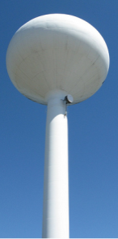
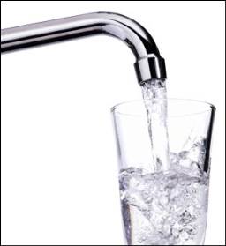
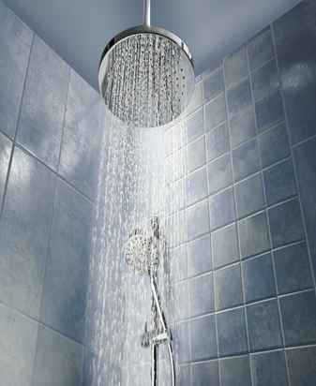
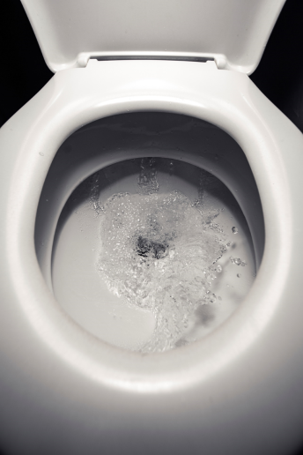
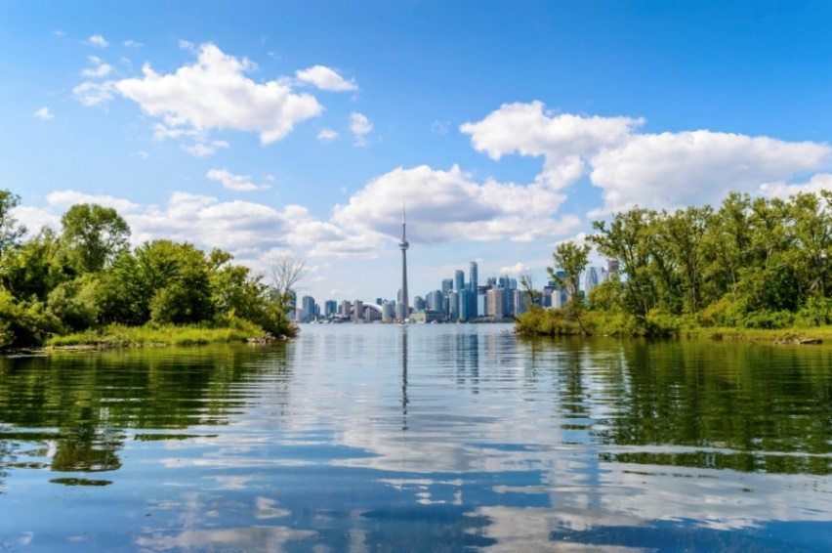
HUMAN WATER CYCLE
Water Treatment Plant
Wastewater Treatment Plant
Notes:
Teacher Note:
(Click-1) Has anyone ever heard about the human water cycle? Have students share their thoughts
If you have already learnt about wastewater treatment, quickly review. If not, additional wastewater treatment lesson plans, resources and virtual tour can be found at peelregion.ca/water-education
What happens when we use water to brush our teeth, shower, go the bathroom – where does it go?
(Click-2) Do we send it directly to the Lake?
Answer: NO, it goes to a wastewater treatment plant

Slide 5
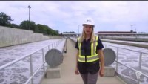
Peel’s wastewater treatment plants
Notes:
Teacher Note:
This short video will show footage from the Region of Peel’s wastewater treatment plants
Before watching the short video, discuss with students
What is the purpose of a wastewater treatment plant?
Watch video: ‘How the Region of Peel cleans your wastewater’ (to play, click the Play button)
https://www.youtube.com/watch?v=4uxYZdnxuz8

Slide 6
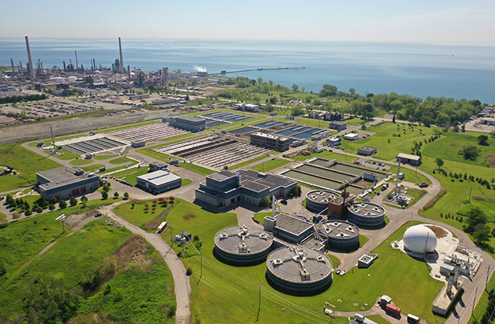
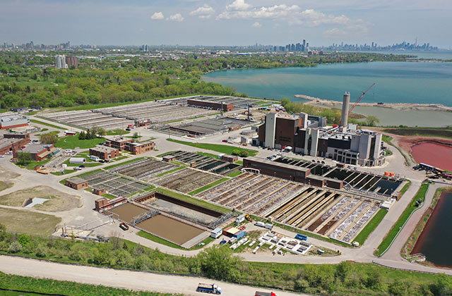
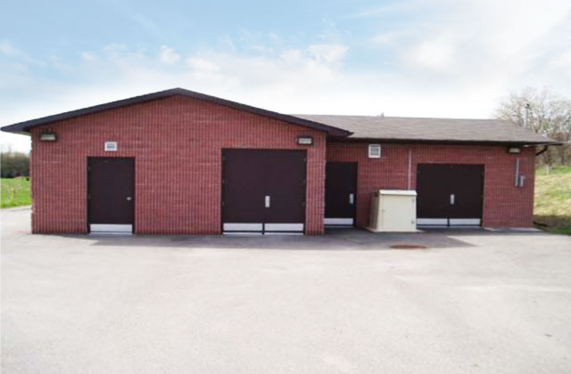
Peel’s Wastewater Treatment Plants (WWTPs)
Clarkson WWTP
Processes the wastewater from homes and businesses on the west side of Brampton and Mississauga.
Treated 86 billion litres of wastewater in 2020 (that’s equivalent to the volume of one Roger’s Centre every week)
G.E. Booth WWTP
Processes the wastewater from homes and businesses in Bolton, Caledon East, and the east side of Brampton and Mississauga, as well as some areas of York Region and the City of Toronto.
Treated 163 billion litres of wastewater in 2020 (that’s equivalent to the volume of two Roger’s Centres every week)
Inglewood WWTP
Processes the wastewater from homes and business in parts of Caledon
Treated 35,000 cubic metres of wastewater in 2020 (that’s equivalent to the volume of 16 hockey rinks every week)
Notes:
Teachers Note:
The locations above are the 3 wastewater treatment plants that operate for the Region of Peel.
Clarkson and GE Booth WWTP’s are the largest and can be found along the shores of lake Ontario. Inglewood is a smaller facility located in Caledon.
Each facility has a unique capacity limit based on its construction and technology. The wastewater virtual tour will take students through the methods of treatment.
Did you know?
The G.E. Booth Wastewater Treatment Plant can treat up to 518 million litres of wastewater per day
In the year 2041 it is estimated that almost 2 million people will live in Peel. That means the wastewater treatment plants will have to continue treating wastewater for even more people in Peel, a task that the Region takes great pride in doing.
Discussion Question:
Based on the description of the three plants, which facility does your school’s wastewater go to for treatment?
Do you think the Region of Peel can treat wastewater for 2 million people? What might the Region need to do or think about in order to be ready?
Explain your reasoning.
Answer: Yes, the Region is committed to providing wastewater treatment for Peel’s growing population. The G.E. Booth Wastewater Treatment Plant (one of 3 treatment plants) alone can treat up to 518 million litres per day. Peel uses population data to forecast future population growth and ensures that the treatment plants are maintained and have enough capacity to treat all the wastewater that is produced.

Slide 7
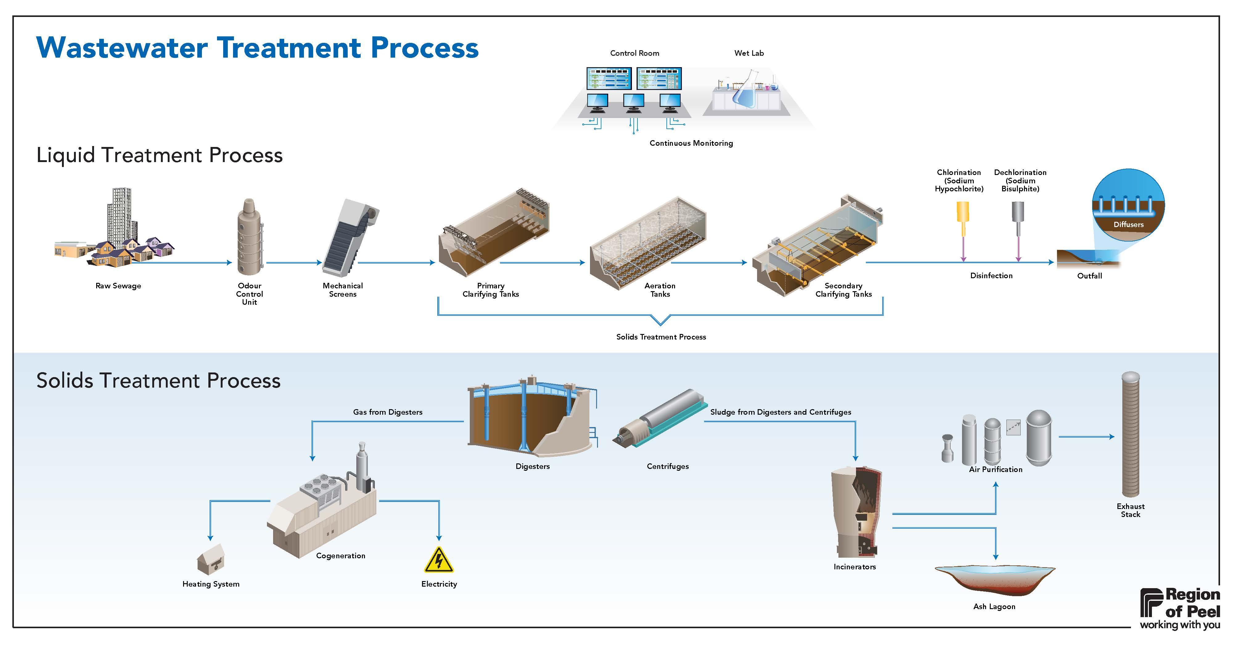
1
2
9
3
4
5
6
7
8
10
11
13
15
16
12
14
17
Notes:
Optional Slide*
Teacher Note:
Reference this schematic of the treatment process throughout your lesson
The different steps of the treatment process are numbered and described below.
The numbers for each part of the treatment process will appear as you click
Use this schematic to provide students with an overview of the treatment process which will be outlined in greater detail in the virtual wastewater tour.
Click to show the different numbers on the slide.
(Click-1) 1. Control Room: Wastewater operators monitor the wastewater treatment process in order to ensure everything is working properly and that treated water meet the standards to ensure the health of the public and the environment. It’s here that they regularly test the water for safety.
(Click-2) 2. Wet Lab: Wastewater operators collect samples at various stages of treatment and test to ensure the treatment process is working as required. It would be quite bad if bits of raw sewage somehow made it past the entire treatment process,
(Click-3) 3. Raw Sewage: Raw sewage is made of anything we flush down the toilet and sink. Raw sewage arrives at the wastewater treatment plants through a large pipe. It contain many unwanted substances such as suspended solids, disease-causing organisms, decaying organic wastes, nutrients and other household and industrial wastes.
(Click-4) 4. Odour Control Unit: Wastewater smells, so we have equipment set up to collect, treat, and control the odours.
(Click-5) 5. Mechanical Screen: These screens capture and remove materials such as dental floss, wood, stones, rags, plastics, metals, and wipes. The screened materials are washed and compacted before disposal. As a result, all the larger materials are removed, but the wastewater still contains many harmful substances,
(Click-6) 6. Primary Clarifying Tanks: To remove some of these harmful substances, they take the water to the Primary Clarifying tanks. Here, heavier solid materials called “sludge” settle to the bottom of the tanks, while lighter material like fats and oils, or “scum” float to the top. The wastewater is then moved to the aeration tanks.
(Click-7) 7. Aeration Tanks: Diffusers at the bottom of the tanks bubble oxygen through the wastewater which promotes helpful microbes that further break down organic material. This also keeps the microorganisms from settling. After this, the wastewater goes to the Secondary Clarifying Tanks for further treatment.
(Click-8) 8. Secondary Clarifying Tanks: Again, the wastewater is slowed down to let the heavier solids fall to the bottom to form sludge. Collection equipment sweeps activated sludge into collection hoppers. A portion of the sludge is returned to aeration tanks and the remainder is removed to the biosolids facility for processing. As for the water itself, it must be disinfected before being released.
(Click-9) 9. Disinfection: First, sodium hypochlorite is added to chlorinate and disinfect the water. Then, sodium bisulphite is added to remove the chlorine from the treated water so that it can be returned to Lake Ontario.
(Click-10) 10. Outfall: Treated water is discharged back into Lake Ontario. Diffusers in the pipe return the water slowly so it doesn’t disrupt plants and wildlife. That’s what happens to the water, but what about the solids that were removed?
(Click-11) 11. Digesters: The sludge and the scum are sent to the digesters. These are large, heated, enclosed tanks without oxygen. Anaerobic digestion takes place here which breaks down organic material in the sludge. The sludge is heated to 38 degrees and mixed to provide good contact between the bacteria and organic material.
(Click-12) 12. Cogeneration: The biogas produced in the digestors is captured and used to generate heat and electricity in the cogeneration unit.
(Click-13) 13. Centrifuge: Biosolids are pumped here from the digestor to have their water content removed. The centrifuge spins the biosolids to dewater the material and reduce its volume. The biosolids from the centrifuge are sometimes called “cake” if they reach a 25% solid concentration.
(Click-13) 14. Incineration: The dried out biosolids are then sent to incinerators to be burned. The incinerators reach 840 degrees Celsius. This process leaves only inorganic material such as phosphorus and iron behind, the rest is ash. For every 100 dry tonnes of biosolids, 10 tonnes of ash are left.
(Click-13) 15. Air Purification: Quenchers and scrubbers filter the air leaving the incinerators to remove harmful trace metals and gases for health, safety, and environmental reasons.
(Click-13) 16. Exhaust Stack: Exhaust air is cleaned and cooled prior to release in the atmosphere. Emissions are constantly checked by a continuous emissions monitoring system.
(Click-13) 17. Ash Lagoon: This acts as onsite storage for ash, which is inert and will not harm the environment. The region is exploring the beneficial uses of ash, such as for bricks and cement for manufacturing or in fertilizer.

Slide 8

I don’t flush
Notes:
Teacher Note:
While our wastewater is constantly being treated, that doesn’t mean we can flush anything we want down our drains and toilets.
Don’t flush:
Pharmaceuticals
Traces of pharmaceuticals are being detected in surface water, groundwater, drinking water, and soil
Pharmaceuticals include both prescription and non-prescription drugs
Instead of flushing, most pharmacies will take back unused/expired pharmaceuticals
Personal Hygiene Products
Examples are baby wipes, tampons, diapers, cosmetics, cotton swabs, dental floss
Flushing these products can damage the sewer system or cause sewer backups
Most of these items should go into the garbage, but some can go to a special drop-off location to be properly disposed of
Household Hazardous Waste
These can contain toxic ingredients and should be used and disposed of with caution
Examples are anti-freeze, bleach, detergents, fertilizers, gasoline, paint, hair dye, etc.
If they’re poured down a drain or sewer, they can enter source waters and be harmful for underwater vegetation and aquatic life
Fats, Oils, Grease
When poured down they drain or toilet, they will cool and form blockages
These can lead to basement flooding and sewage overflows onto streets
Can also damage the wastewater treatment plants and require costly repairs
Instead, scrape fats, oils, and grease into the green bin
Discussion Questions:
What are some larger objects that get removed through a mechanical screen in wastewater treatment? What can we do to prevent this material from arriving at the treatment plant?
Answer: Wood, stones, dental floss, plastics, metals. These materials should not be put down the drain.
What would happen if we didn’t properly treat our wastewater before sending it back into nature?
Answer: It could hurt human and environmental health, close beaches, lead to restrictions on water recreation and harm the fishing industry.

Slide 9
Everyone plays a part in protecting and conserving our water!
Keep this in mind as you continue to the Wastewater Treatment Plant Virtual Tour.
Notes:
Teacher Note:
End of the lesson, ask students
What have they learned today about wastewater treatment?
Have students share their findings
Share with students that everyone including them, have a part in protecting and conserving water
Ask students to refer to the handout in preparation for the virtual tour. There are two options: teacher-led, or student self-exploration.
Refer to the Teacher Guide for the tour outline and additional discussion points.

